Slide 1
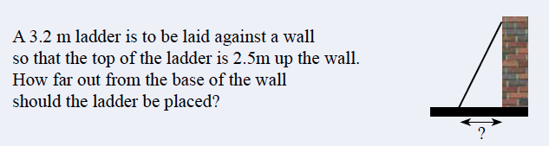
Starter

Slide 2

Pythagoras’ Theorem
Learning Objectives:
Be able to label a right angled triangle
Be able to use Pythagoras to find the
hypotenuse
Able to apply to worded problems

Slide 3
Pythagoras’ Theorem
KEY WORD:
Hypotenuse: The longest side on a right angled triangle
Found opposite the right angle.

Slide 4
Pythagoras’ Theorem
c
hypotenuse
hypotenuse
c
b
c
hypotenuse
b
a
b
a
a
Which of these sides is the hypotenuse?

Slide 5
Pythagoras’ Theorem
On your Graph Paper, draw a Right Angled Triangle with side lengths of A 3cm, B 4cm and C (hypotenuse) 5cm. Draw the square of each side and label it. Count each of the squares of sides A and B. Does their sum match the square of side C, the hypotenuse? Cut your diagram out and paste it into your Task Page.

Slide 6
Pythagoras’ Theorem
https://www.youtube.com/watch?v=CAkMUdeB06o
https://www.youtube.com/watch?v=uaj0XcLtN5c&t=1s
c² = a² + b²

Slide 7
Which of the sides in these triangles is the hypotenuse?
a
c
a
c
b
b
Calculate the length of c.
c
5cm
12cm

Slide 8
Pythagoras’ Theorem
Learning Objectives:
Be able to label a right angled triangle
Be able to use Pythagoras to find the
hypotenuse
Able to apply to worded problems

Slide 9
Pythagoras’ Theorem
Exercise 7-2, page 91
Q1 – 6
Sketch the triangles and show your working out

Slide 10
Plenary
A plane flies due north for 180km, then due west for 260km. How far is the plane from it’s starting position?
  Draw and label a triangle to represent the situation
  Write out the formula you’d use to answer the question
  Find the distance

